Slide 1
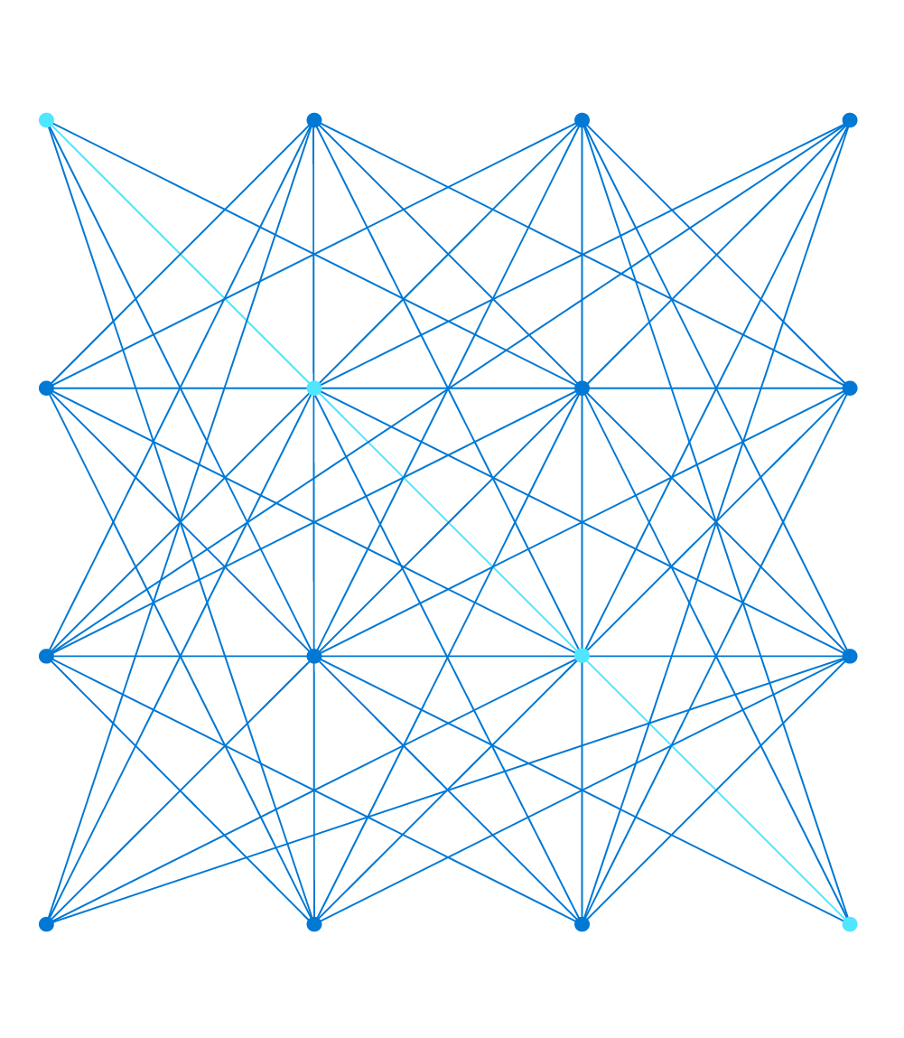
AI-900 Azure AI Fundamentals
Notes:
Before You Start
Complete the online modules in the https://aka.ms/no-code-ml learning path – including the hands-on exercises.
We recommend preparing for the delivery by having completed versions of the following online exercises ready to demonstrate:
Use automated machine learning in Azure Machine Learning
Create a classification model with Azure Machine Learning designer
This deck contains a number of animated slides, with accompanying suggested scripts in the presentation notes. We recommend you practice delivering these slides until you are familiar with the flow and key talking points.

Slide 2
Module 2 Machine Learning

Slide 3

Learning Objectives
You will learn the following concepts:
Introduction to machine learning
What is machine learning?
Regression
Classification
Clustering
Azure Machine Learning
What is Azure Machine Learning?
Automated Machine Learning
Azure Machine Learning designer

Slide 4


Lesson 1 Introduction to Machine Learning
Notes:
This lesson covers some basic principles of machine learning. It's important for students to understand these principles to provide a context for the Azure services we'll explore later in the module.
There's some basic mathematics involved, and some students may find this intimidating. Take it slowly and emphasize that the goal is not to teach linear algebra or probability theory – just to help students gain an "intuition" into how machine learning works so that the configuration and evaluation options in the Azure Machine Learning interface make sense.

Slide 5








What is Machine Learning?
Creating predictive models by finding relationships in data
Bellis Perenis
Rosa Multiflora
Rosa Multiflora
Bellis Perenis
Tulipa
Bellis Perenis
Tulipa
Tulipa
Bellis Perenis
Rosa Multiflora
Notes:
This is an animated slide – use the notes below to talk to each animation build (clicks are indicated by numbers)
Machine Learning is a technique we can use to create predictive models based on relationships in data.
So what does that mean? Well, let's look at an example:
Suppose a botanist collects some samples of flowers. {The slide shows images of various flowers}
Each sample has some features, such as measurements of the petals, stem, and other details); and the botanist can provide a label for the flower using its species name. {The Latin name for each flower species appears}
The sample data is then processed using an algorithm that tries to find a relationship between the features and the label. {The flowers are fed into a pair of turning cogs}
The result of this algorithm is a machine learning model. {A human head with cogs for a brain appears}
And since the model has learned the relationship between the features and label, you can use it to predict the species of a flower based on its features. {A new flower appears, and the human head identifies its species}

Slide 6
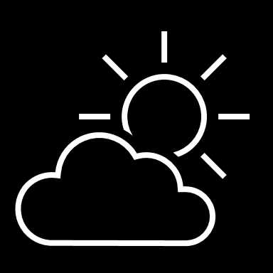
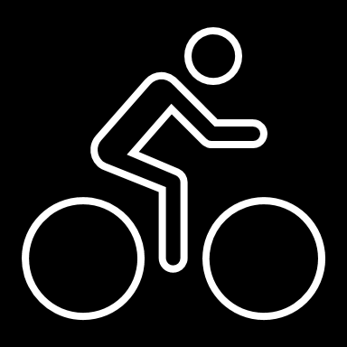
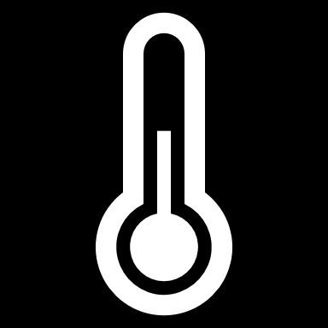
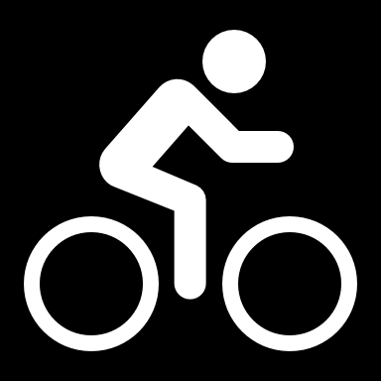
Regression
56 | 115
61 | 126
67 | 137
72 | 140
76 | 152
82 | 156
x y
Training
ŷ
116
128
137
146
155
1.5
f(x)
1
35
f(x)=35 + 1.5x
54 | 114
62 | 129
68 | 130
74 | 152
80 | 154
Validation
Notes:
This is an animated slide – use the notes below to talk to each animation build (clicks are indicated by numbers)
One of the most common machine learning technique is called regression. You use regression when you want to predict a numeric value; like a price, a sales total, or some other measure.
Let's look at an example and get an idea of how it works. There's a little mathematics involved, but don't worry – the basic idea is fairly straightforward!
In this example, we'll imagine a bicycle rental company that wants to predict the number of rentals on a given day based on weather conditions.
We'll start with some historical data about cycle rentals. For this simple example, we'll restrict this to just the temperature and number of rentals per day. In reality there would be more factors to consider. {A table of data showing daily temperatures and the number of rentals appears}
The number of rentals is the label we're going to predict, and we're going to use the daily temperature as a feature on which to base the prediction. Generally, we refer to the feature (or features) as X and the label as Y; and what we're going to do is to try to figure out a function that we can apply to X to get the value of Y. This function will be the basis for a model that we can use to predict Y for any given value of X. {X appears above the temperature column, and Y appears above the rentals column}
When we find a function, we'll want to validate it with some data for days where we already know the number of rentals so we can see how well it predicts; so we'll split the data into a subset that we'll use the train the model, and hold back a subset for validation. {The table is split into a training subset and a validation subset}
To find an appropriate function, let's plot the X and Y values so we can visualize the relationship between them. {A chart showing X values plotted against Y values from the training subset is displayed
Looking at the plot, you can see a trend in which higher temperatures tend to correlate with more rentals. In fact, we can fit a line between the plotted points that more or less describes this correlation and we can use this line to work out a calculation that produces Y from X. The ability to use a line like this to define a function for the X/Y relationship is technically called linear regression; which sounds complicated, but let's look at the basic principle of how it works and hopefully you'll find that it's actually fairly intuitive. {A diagonal line showing a trend where high X values tend to correlate to high Y values is added to the chart}
The point where the line intercepts the Y axis is around 35… {The point where the line intersects the Y axis is highlighted on the chart}
…and the slope of the line is such that for every 1 unit of X it goes along, it goes up around 1.5 units of Y… {The slope of the line is shown by an arrow going left for 1 unit and an arrow going up for 1.5 units}
…so the function that operates on X to find Y is 35 plus 1.5 times X. {The function "f(x) = 35 + 1.4x" is displayed}
Now we can test that function with the validation data that we held back. Here are the values we get from the function for the temperatures on those days – because this is a prediction of Y rather than the actual Y value, we write it with a little "hat" and call it Y-hat. {A column of values calculated by using the function is added alongside the actual Y values in the validation subset}
Let's plot the actual values from the validation data along with the line from which the predicted values were calculated. {The actual values from the validation subset are plotted on the chart alongside the line that represents the predictive function}
Now we can see how well the model predicts by measuring the difference between the predicted values and the actual values that we know to be true – this tells us the amount of error in the model. There are various ways to calculate this error value and generate common metrics that we can use to evaluate a regression model. {Arrows indicating the distance between each actual value and the prediction function line are added to the chart}
This is a simple example, just to describe the general concepts and process for training and evaluating a regression model. In a real-world scenario, the training algorithm would need to fit multiple features (X values) to a regression function; but the basic principles remain the same. You start with some data that contains features and labels, you use some of the data to train a regression model by using an algorithm that tries to determine a function for X that predicts Y; and then you evaluate the trained model using the validation data that you held back. If you're happy with the level of error in the model, you can then use it to infer unknown label values in new cases.

Slide 7
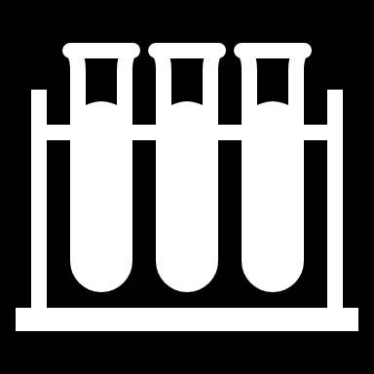
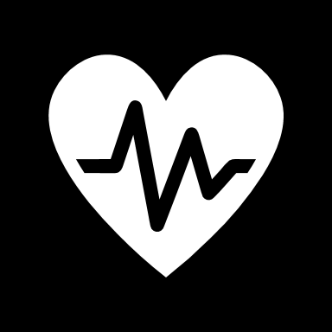
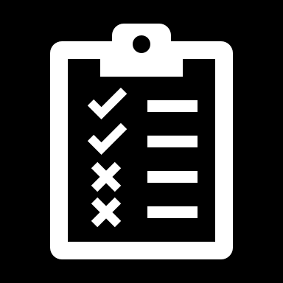
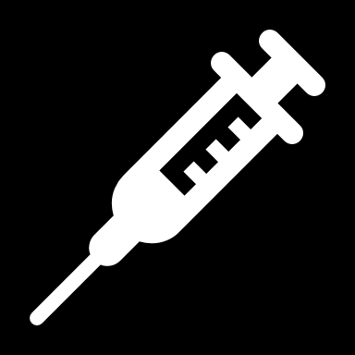
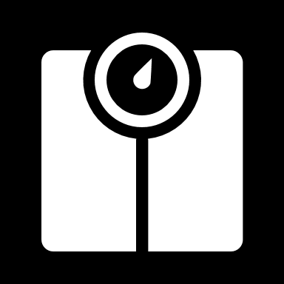
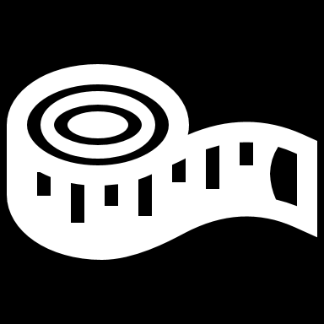


Classification
Actual
[4,2,3.2,10] | 0
[6,3,1.7,12] | 1
[5,2,3.5,11] | 0
[4,1,2.9,10] | 0
[7,4,2.1,11] | 1
1
0
126
1
1
21
1
[7,3,1.8,11]
[7,4,2.1,11]
x y
Predicted
True Positive
7
119
1
1
0
[6,3,1.7,12]
Training
[4,8,2.5,10]
False Positive
[4,1,3,1,11]
[5,2,3.5,11]
False Negative
P(1) | P(0) | ŷ
0.2 | 0.8 | 0
0.9 | 0.1 | 1
0.6 | 0.4 | 1
0.3 | 0.7 | 0
[3,1,2.8,10] | 0
[7,3,1.8,11] | 1
[4,8,2.5,10] | 0
[4,1,3,1,11] | 1
[4,2,3.2,10]
[3,1,2.8,10]
True Negative
[4,1,2.9,10]
Validation
Notes:
This is an animated slide – use the notes below to talk to each animation build (clicks are indicated by numbers)
Regression is a form of supervised machine learning – in other words it relies on us having some data with known label values that we can fit to a model, which can then be applied to new data for which we don’t have the label values. Now let's look at another type of supervised machine learning – classification.
Again, there's some mathematics involved – in particular, probability. Don’t worry too much about the details – just remember that probability is always a value between 0 and 1, where 1 means a definite, 100% certainty.
Just as with regression, we start with some data that includes features and known labels. In this case, the features are medical measurements that might be taken during a health checkup – such as weight, height, blood pressure, and so on. This time, the label isn't a numeric value but an indicator of whether the patient is diabetic (in which case the label has a value of 1) or not (in which case it is 0). The label indicates to which class the patient belongs – diabetic or non-diabetic. {A table of data appears. In the first column, the values are vectors (lists) of diagnostic measurements. The second column contains a 1 or a 0}
Once again, we split the data into subsets for training and validation. {The table is split into training and validation subsets}
Now, we'll take the training values and apply an algorithm that fits them to a function so that the Y value is between 0 and 1, like this. {A chart showing the feature vectors plotted against the label values is displayed
Since the value can be anywhere between 0 and 1, a threshold value is used to determine the cut-off point where the class is considered to be 0 or 1. In this case, all patients with features producing a value greater than 0.5 are diabetic, and those with values below that threshold are not. {A line is added to the chart at the 0.5 threshold – all points plotted above this represent diabetic patients, and all points below represent non-diabetic patients}
The function we've fitted to the data is an example of a logistic function. You can think of the value as representing the probability that the class is 1 (in other words, that the patient is diabetic). {A Sigmoidal (s-shaped) function graph is shown with a minimum value of 0 and a maximum of 1}
Having determined a function that fits our features, a model is produced and we can use the validation data we held back to test it. Here are the results of applying the logistic model to our validation features. {The validation data points are plotted on the chart alongside the predictive function}
The function returns the probability that the class is 1, or positive, as a value between 0 and 1; and since there are only two possible classes, and there's a 100% probability that the patient is one of them (they're either diabetic or not!), the probability that the class is 0, or negative, is also known (it's just 1 minus the probability that it's positive) The class with the highest probability is the predicted value for Y. {A table showing the probability values for each possible class calculated by the function, and consequent 1 or 0 class prediction, is shown alongside the validation subset}
Let's look at the first validation case. In this case, the predicted class label is 0 and the actual label is also 0, so the model got it right. It's a true negative. {A tick appears alongside the first prediction}
The second case results in a prediction of 1 for an actual value of 1, so again it's correct – this time it's a true positive. {A tick appears alongside the second prediction}
For the third case, the prediction is 1 but the actual label is 0, so the model got this one wrong – it’s a false positive. {A cross appears alongside the third prediction}
The fourth one is also wrong – this time, a false negative. {A cross appears alongside the fourth prediction}
To evaluate the model, we tabulate the prediction results in a format called a confusion matrix, like this. {A 2 by 2 matrix of actual labels of 1 and 0 crossed with predicted labels of 1 and 0 is displayed, and the plotted points move to the appropriate quadrant of the matrix based on their predicted and actual values}
In a real scenario, you'd use much more validation data than we have on the slide, so it might end up looking something like this. {The numbers in the matrix increase to show 126 true positives, 7 false positives, 119 true negatives, and 21 false negatives}
If we apply a heatmap to this, intensifying the cells in the matrix to reflect the values, you can easily see that the correct predictions in the true positive and true negative cells form a dark diagonal line from top left to bottom right – indicating that the model got more predictions right than wrong. {The quadrants in the matrix are shaded, with higher values darker than lower values – this reveals a diagonal pattern of high values for true positives and true negatives}
From the values in the confusion matrix, you can calculate multiple metrics that can be used to measure the performance of the model.

Slide 8
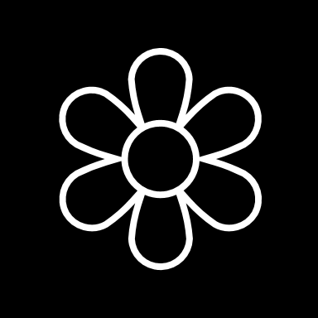


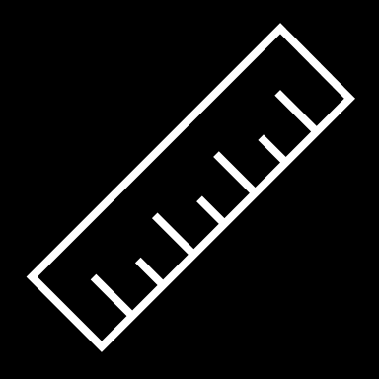




Clustering
 | 6 | 3
 | 5 | 3
 | 2 | 3
 | 1 | 3
 | 3 | 8
 | 4 | 8
Notes:
This is an animated slide – use the notes below to talk to each animation build (clicks are indicated by numbers)
Regression and Classification are both forms of supervised machine learning.
Now let's look at a form of unsupervised machine learning – clustering.
Suppose we collect some observations of flowers, noting the height and number of petals for each sample. What we want to do is group flowers that are similar together, but we have no known label that we can use to train a model. {A table of flower heights and petal counts is shown}
Instead, we think of the feature values that we have as being coordinates on which we can plot the sample data points – in this case we have two features, height and petals, so we can plot them on a 2-dimensional grid like this. {A grid is shown with flowers plotted for each height and petal count coordinate pair}
Now we need to decide how many clusters we want to group the observations into. This value is generally referred to as K, and we simply assign K points at random locations on our grid like this. In this case, we've used a K value of 3; so we'll end up with 3 clusters. {Three centroid points are plotted on the grid at random coordinates}
Each of the K points we've plotted will be a centroid for a cluster, so we assign the sample data points to its nearest centroid. {Three shaded cluster areas enclosing the flowers that are nearest to each randomly plotted centroid is added}
Now we move each centroids to the middle of the points in its cluster – based on the mean distance. {The centroid points are moved to the center of the flowers in their cluster}
Now that the centroids have moved, some sample points might be nearer to a different centroid from the one they're currently allocated to; so we reallocate the samples to their nearest centroid. {The cluster shapes are redrawn to reflect the flowers that are now closest to each centroid}
And then we just repeat the process until the clusters are stable, or we reach a pre-determined maximum number of iterations. In this case, the clusters soon stabilize as well-separated groups of related flowers. {The centroids are iteratively moved to the middle of their cluster and the clusters reallocated until a stable set of separated clusters is defined and the centroids are fixed in the middle of their flowers}
This clustering technique, which uses K centroids and moves them to the mean distance between their data points is known as K-Means clustering.

Slide 9

Lesson 2 Azure Machine Learning

Slide 10


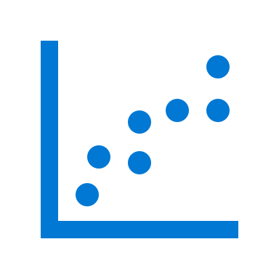




What is Azure Machine Learning?
A cloud-based platform for machine learning
Compute
Experiments
Services
Data
Models
Azure ML Workspace
Azure Subscription
Notes:
This is an animated slide – use the notes below to talk to each animation build (clicks are indicated by numbers)
Azure Machine Learning is a cloud-based platform for machine learning.
To use Azure Machine Learning, you need a Microsoft Azure subscription. {A cloud appears}
In that subscription, you create an Azure Machine Learning workspace. A workspace is a logical container for resources you need to manage machine learning projects. {Within the cloud, a rectangle representing a workspace appears}
One of the most important resources is compute. You need this to run machine learning workloads in the cloud instead of on your local computer. {Within the workspace, a computer appears}
You'll also need to manage the data you need to build machine learning solutions. {Within the workspace, a disk appears}
You can then use the data to run experiments on the compute resources. {Within the workspace, a graph appears}
Often, your experiments are used to train models; which you'll register and manage in your workspace. {Within the workspace, a model appears}
And when you're ready to use your models in applications, you can publish them as services that can be accessed over HTTP connections. {Within the workspace, a cog appears}
After talking through the slide animations, open the Azure portal (https://portal.azure.com) in a web browser and demonstrate the first few steps of creating an Azure Machine Learning workspace. Then use your existing workspace from your completion of the online learning path to demonstrate how to get from the Azure portal to Azure Machine Learning Studio (https://ml.azure.com) and show students the Compute, Data, Experiments, Models and Endpoints pages.
On the next slide, you will find a screenshot of the Azure Machine Learning Studio homepage, which you can optionally use to orientate students to the workspace.

Slide 11
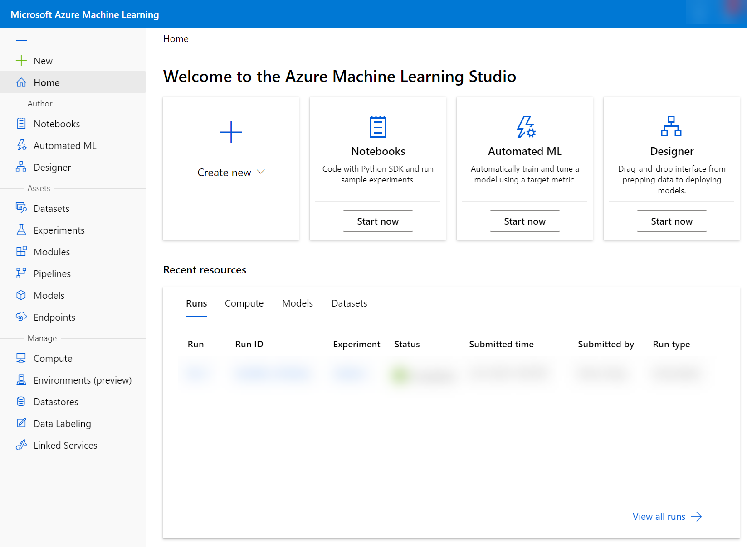
Azure Machine Learning Studio
ml.azure.com
Notes:
You can interact with your ML workspace in the following ways:
On the web (with the Azure Machine Learning Studio, shown above)
In a python environment with the Azure Machine Learning SDK (we will not be covering this)
On the Command Line (we will not be covering this)
Note: It might be helpful to point out to students that they can find features in the left-hand panel, specifically:
Notebooks
Automated ML (the lab in class will use Automated ML)
Designer (other labs in Learn cover Designer)
Datasets
Experiments
Models
Endpoints
Compute

Slide 12

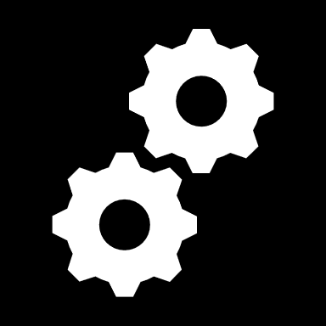

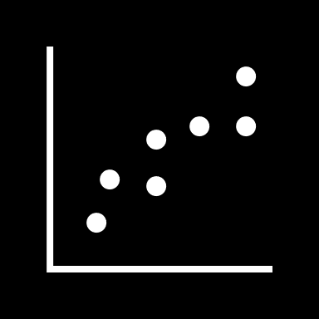
Automated Machine Learning
Takes the hard work out of machine learning
Supply the data and desired model type, and let Azure Machine Learning find the best model
Data
Model
Notes:
Automated Machine Learning in Azure Machine Learning provides the easiest way to train a machine learning model for regression or classification (or forecasting, which is really just regression with a time-series element). There's a visual interface for automated machine learning in the Azure Machine Learning studio web portal. You just need to supply the training data and select the required model type, and Azure ML does the rest.
Later, in the lab, students will get a chance to try this for themselves, but for now demonstrate the first few steps using your own Azure Machine Learning studio instance, cancelling before starting the training experiment, Then show students the result of the experiment you complete previously in the Use automated machine learning in Azure Machine Learning online module, demonstrating how to view the best model and its metrics. Finally, show the deployed endpoint and demonstrate the notebook used to consume it.

Slide 13
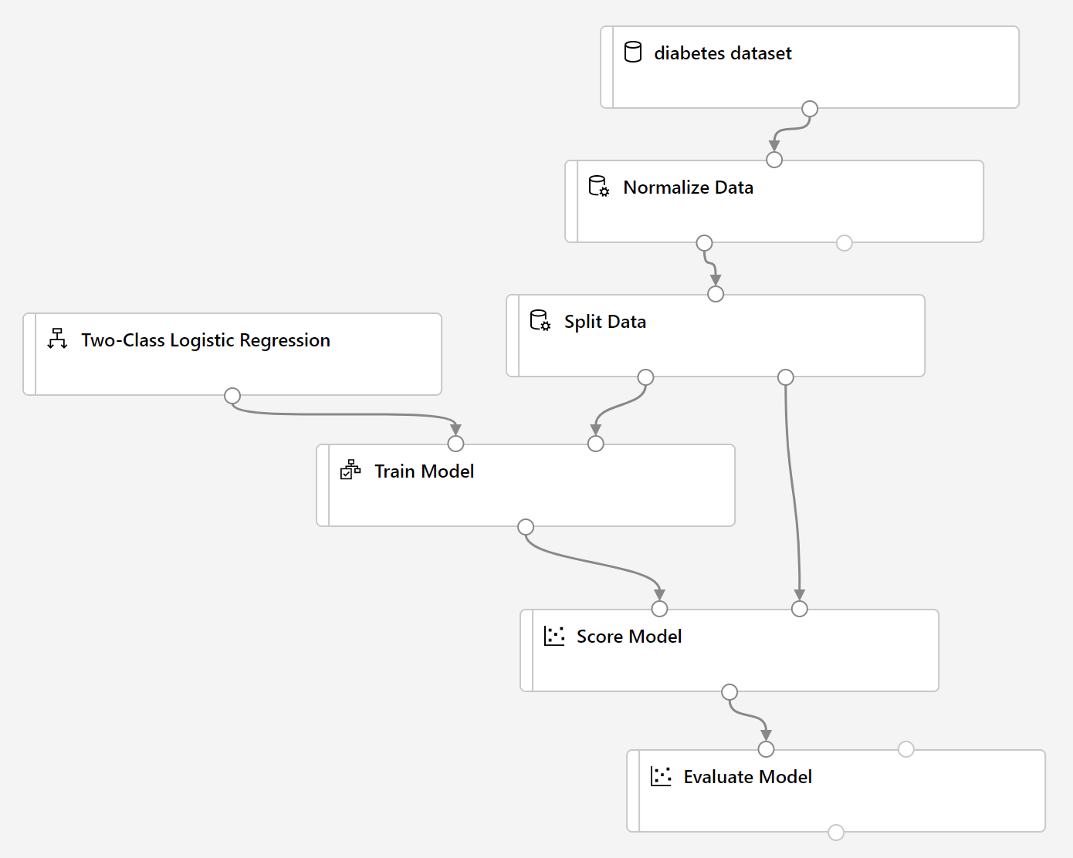
Azure Machine Learning designer
Visual tool for creating a machine learning pipeline
Use a training pipeline to train and evaluate a model
Create an inference pipeline to predict labels from new data
Deploy the inference pipeline as a service for apps to use
Notes:
In Azure Machine Learning, multi-step workflows to prepare data, train models, and perform model management tasks are called pipelines. The designer tool in Azure Machine Learning studio enables you to create and run pipelines by using a drag & drop visual interface to connect modules that define the steps and data flow for the pipeline.
You can either use the image on the slide and the notes below to describe the overall process, or use the training and inference pipelines you created when completing the Create a classification model with Azure Machine Learning designer online module to talk students through the end-to-end process, finishing with the deployed endpoint and the notebook code used to consume it.
On the left side of the slide, you can see the overall workflow for using designer:
Start by creating a pipeline that ingests and preprocesses a dataset before training and evaluating a model.
When you're happy with the model's performance, create an inference pipeline based on your training pipeline. This encapsulates the data preprocessing steps and the trained model so you can use it to predict labels for new data.
When the inference pipeline is ready, deploy it as a service that client applications can use.
On the right side of the slide, you can see an example of a training pipeline. Note the following key points about this:
The pipeline starts with a dataset – in this case containing patient data that includes a diabetes diagnosis (remember the classification example from earlier?)
Before training, data is usually preprocessed to clan it up or otherwise make it more suitable for modeling. In this case, the numeric features in the data (height, weight, diastolic blood pressure, and so on) are normalized – which means to convert them all to be on the same scale. This is a common preprocessing step for numeric features, and designer includes a Normalize Data module to do it.
Next, a Split Data module is used to randomly split the dataset into training and validation subsets. This is a common step in a supervised learning pipeline so that you can evaluate the model using data with which it wasn't trained.
The training subset is connected to a Train Model module, which in this case will fit the data to a function that predicts a diagnosis of diabetic or not-diabetic. This is a classification function with two possible classes, so an appropriate binary classification algorithm must be used to train the model. In this case, a Two-Class Logistic Regression algorithm has been used – but designer includes multiple, algorithm options you can choose from.
After training, a Score Model module is used to score the validation data (in other words, use the trained model to predict labels from the features).
The validation data includes the actual label value, so we can compare this to the predicted label produced by the Score Model module and use an Evaluate Model module to calculate metrics to help us determine if the model is any good or not. For a classification model like this, these metrics include simple accuracy as well as a confusion matrix of true positives, false positives, true negatives, and false negatives from which other, more discerning metrics can be derived.

Slide 14
Lab Azure Machine Learning
Launch the hosted environment.
Complete the lab on Azure Automated Machine Learning.
Notes:
The lab should take most students between 45-60 minutes.
Tell students to launch the hosted environment named: AI-900 Module 02 and complete the lab in the browser there.
You can find the Learn units associated with this lab at https://aka.ms/no-code-automl. You may want to go over the Learn units with students before they start working on the lab themselves.
Remind students to use the Azure subscription they created for this course.
Encourage students to sign into the Microsoft Learn site and complete the knowledge review on the summary page to earn achievement points.
Suggest students follow the steps to delete their Azure Machine Learning workspace, delete their published service, stop their compute instance, and reduce the number of nodes in their compute cluster to zero to clean up their resources when done with the lab.

Slide 15
Module Overview
We covered the following concepts:
Introduction to machine learning
What is machine learning?
Regression
Classification
Clustering
Azure Machine Learning
What is Azure Machine Learning?
Automated Machine Learning
Azure Machine Learning designer

Slide 16

Explore Further on Microsoft Learn
Create no-code predictive models with Azure Machine Learning
https://aka.ms/no-code-ml
Notes:
Encourage students to review the online modules to learn more and try out the hands-on exercises that there isn't time for today - especially if they plan on pursuing certification.
Remind students that that https://aka.ms/no-code-ml is a short-cut directly to the learning path related to this module. Students can also find the learning path from the https://docs.microsoft.com/learn/certifications/azure-ai-fundamentals certification landing page.

